Slide 1
Assignment Progress - Kelvin and Matt

Slide 2
Hello!
We are group Foxtrot
And we would like to present our progress on Assignment 3

Slide 3
Overview
1
Page types?
Desktop or mobile?

Slide 4
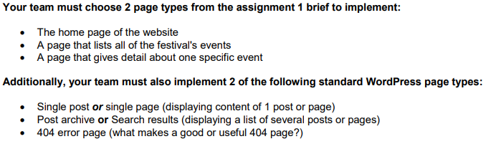

Page Types
https://moodle.vle.monash.edu/pluginfile.php/7466736/mod_resource/content/1/Presentation%203.pdf [14] References.

Slide 5



We chose Desktop!
Audience?
Creativity Limitations
Clarity
https://readwrite.com/2011/05/05/5-pros-and-cons-to-the-mobile-desktop/ [3] References.

Slide 6
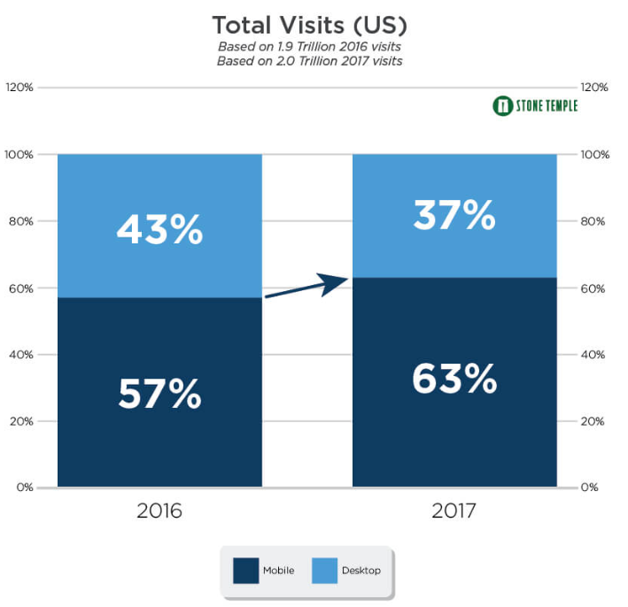

Audience
https://www.stonetemple.com/mobile-vs-desktop-usage-study/ [1] References.

Slide 7
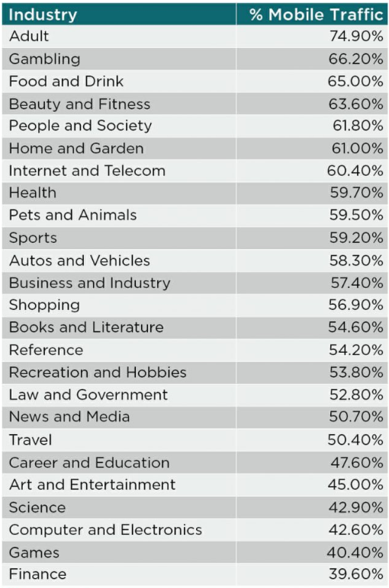
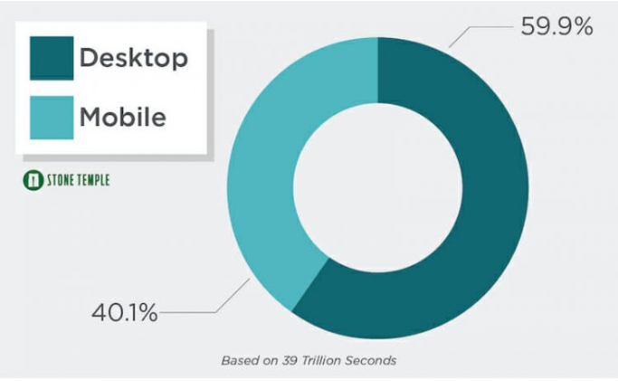
Audience
https://www.stonetemple.com/mobile-vs-desktop-usage-mobile-grows-but-desktop-still-a-big-player-in-2017/ [2] References.

Slide 8
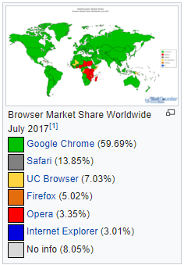
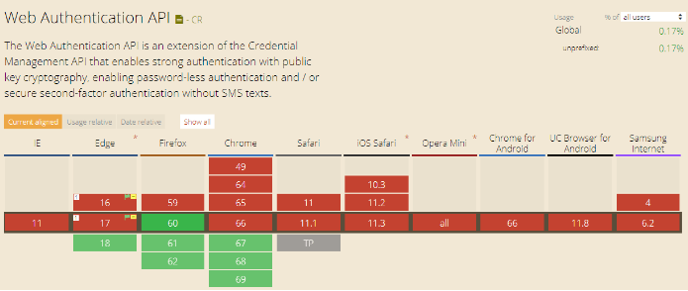
Creativity Limitations
https://en.wikipedia.org/wiki/Usage_share_of_web_browsers
[5] References.
https://medium.com/@sarahelson81/how-to-make-a-cross-browser-compatible-website-40796eaeda05
[4] References.

Slide 9

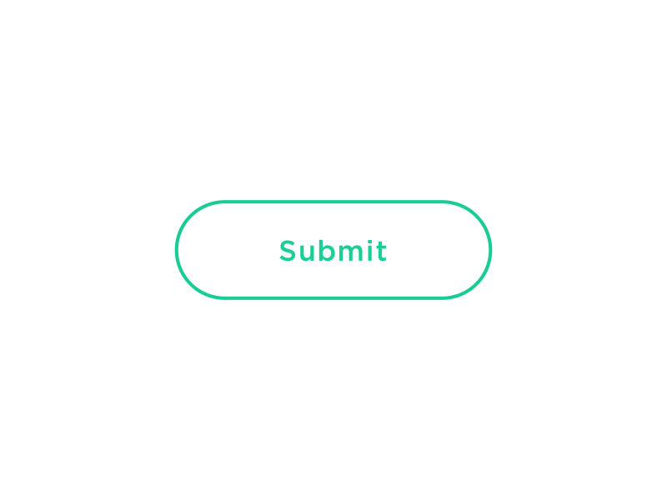
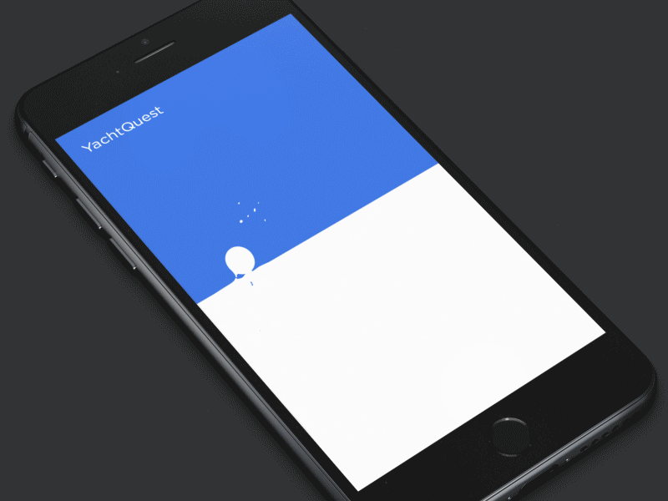
Creativity Limitations
https://www.shopify.com.au/partners/blog/using-animation-to-improve-mobile-app-user-experience
[6] References.

Slide 10
More Clarity
Compact
Less examples
Hamburgers don’t help with sub-sections
Scroll
https://readwrite.com/2011/05/05/5-pros-and-cons-to-the-mobile-desktop/ [3] References.

Slide 11
Design Re-development
2
What have we researched?

Slide 12
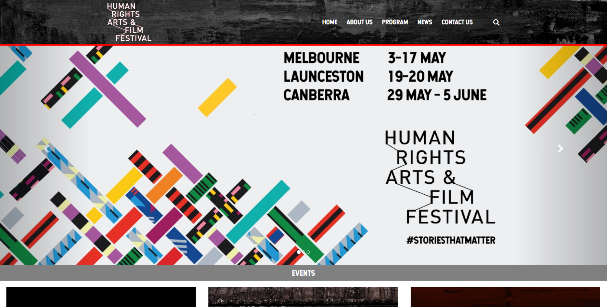

Slide 13
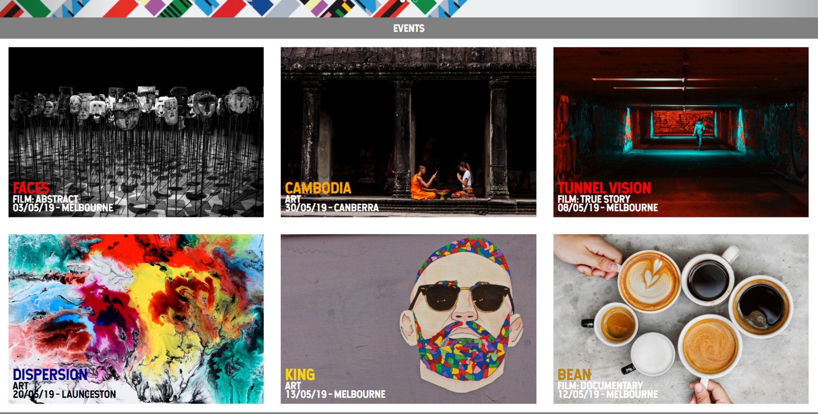

Slide 14
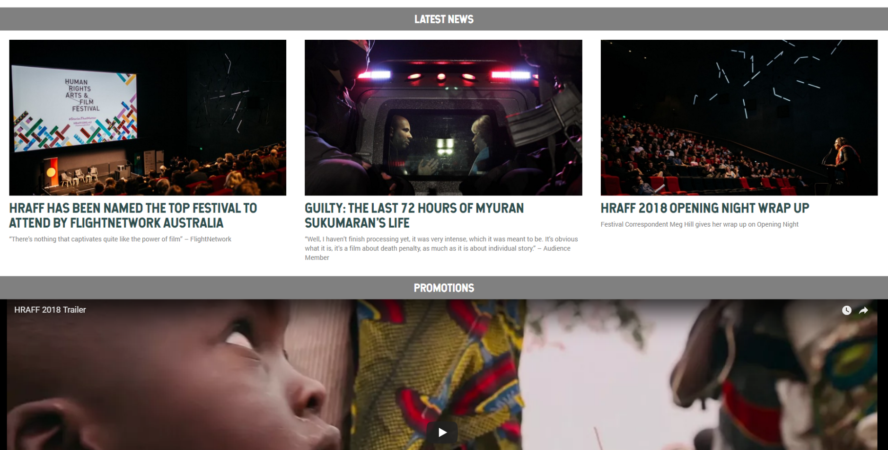

Slide 15

Branding Elements
We will be retaining most of the same branding design, the main changes with the design will be usability and scaling aspects
Mainly greyscale colour scheme with highlights in bright colours, aesthetically pleasing to users
Grey paint texture for the navigation bar, authentic feeling
Fonts: ‘Hansief’ for headings, ‘Roboto’ for body
🎨

Slide 16

Shneiderman’s 8 Golden Rules
Strive for consistency.
Seek universal usability.
Offer informative feedback.
Design dialogs to yield closure.
Prevent errors.
Permit easy reversal of actions.
Keep users in control.
Reduce short-term memory load.
https://www.cs.umd.edu/users/ben/goldenrules.html [8] References.

Slide 17
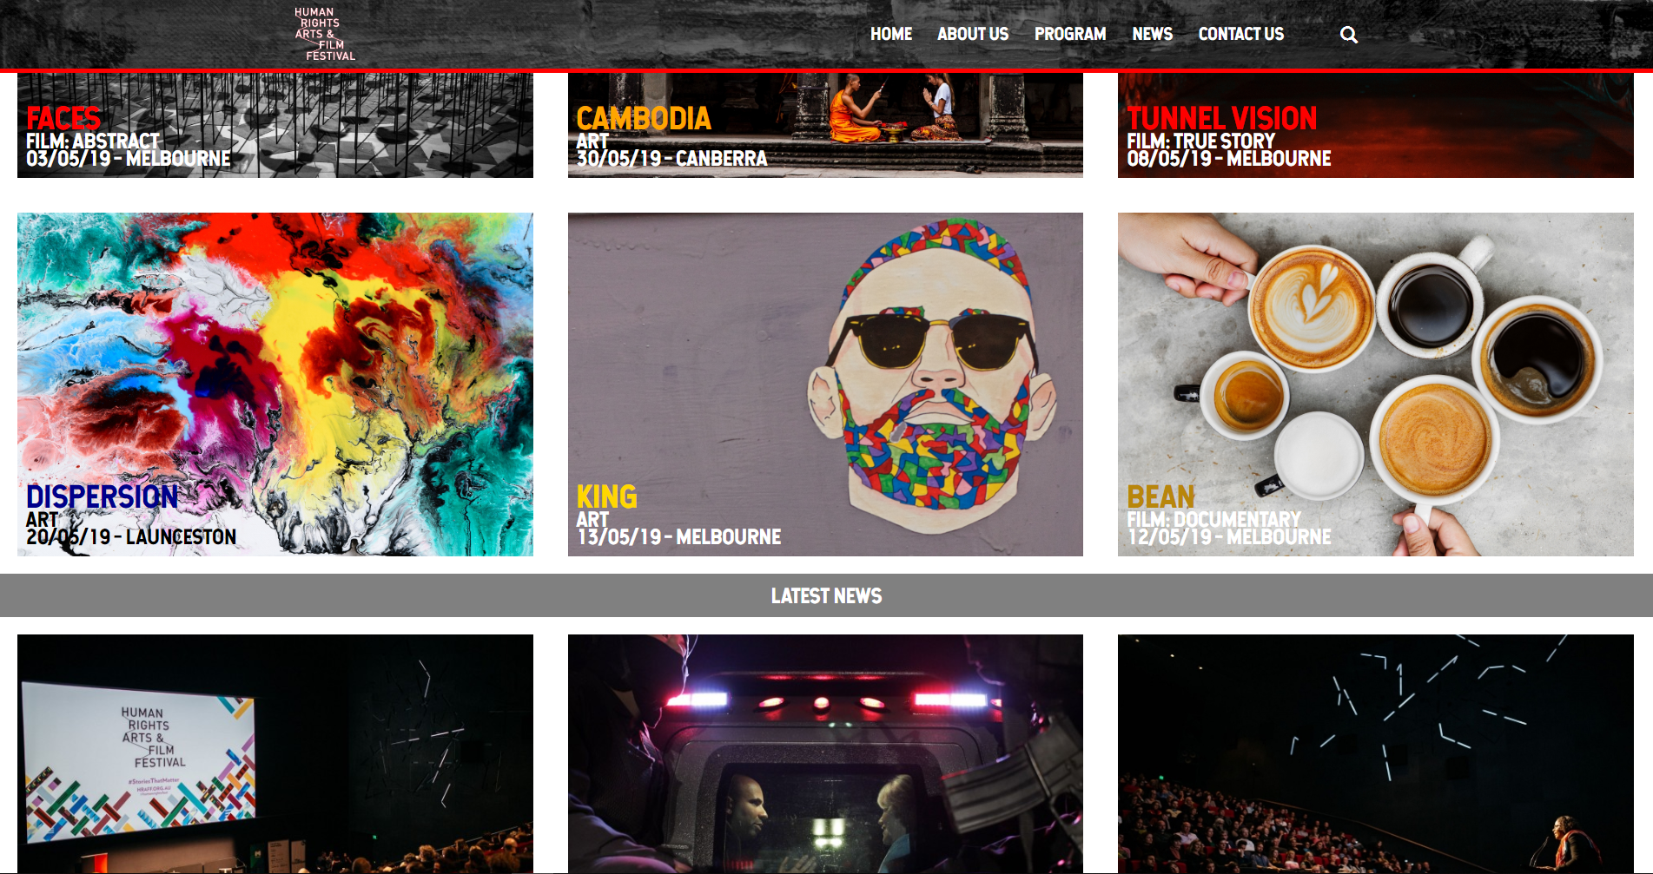

1. Strive for consistency, 2. Seek universal usability
Consistent page elements: grid structure and spacing
Consistent typeface and colour scheme
Universal usability: increasing the size of navigation and sub-headings from the original design

Slide 18
6. Permit easy reversal of actions
Intended inclusion: breadcrumb trail so users can easily navigate backwards without needing to use browser buttons
Events > Art > King (Melbourne)
News > Guilty: the last 24 hours …

Slide 19
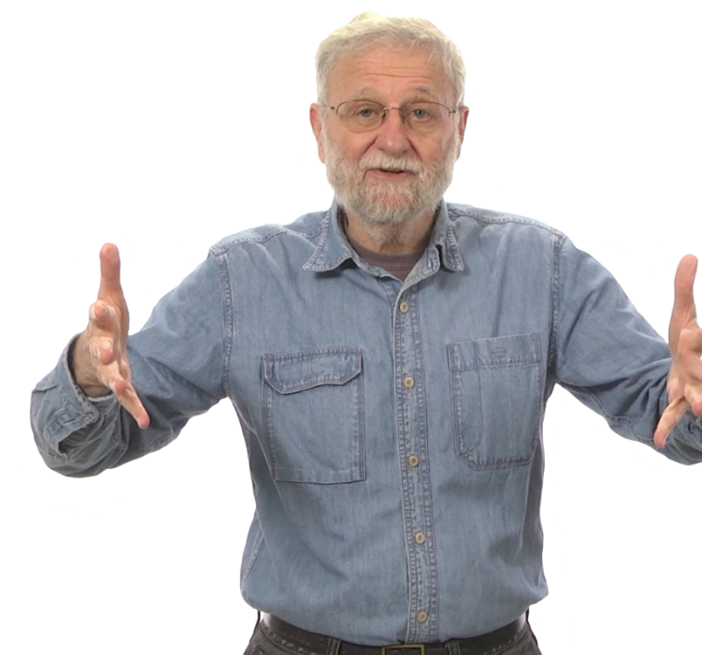
Norman’s 7 Principles (Design of Everyday Things)
Discoverability/Visibility
Feedback
Conceptual Model Consistency
Affordance
Signifiers
Natural Mappings
Constraints
Norman, D. (2013). The design of everyday things. New York: Basic Books. [9] References.

Slide 20

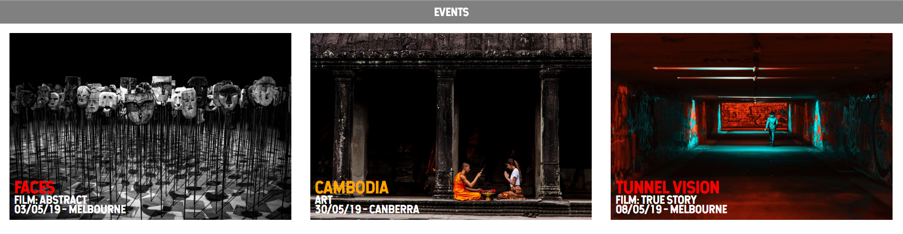
1. Discoverability/Visibility
Carousel should be reduced in height so that the page elements below are more visible to users upon initial glance

Slide 21
3. Conceptual Model Consistency, 5. Signifiers
Page navigation is in the expected location, in the top bar
Arrows for navigating carousel will be made larger so they are easier to see

Slide 22
Content Architecture
3
What are we going to implement?

Slide 23
Standard Posts
Posts contain information including title/headline, author, category, tags and summary
Collated in chronological order
Will be useful for the news article posts because they do not require information additional to the standard post type
https://www.smashingmagazine.com/2012/11/complete-guide-custom-post-types/ [10] References.

Slide 24
Custom Post Types
Allows the developer to modify a large range of options for the posts
It would be suitable for events posts which have more data requirements than the standard posts allow for
Additional requirements include
Location
Date & Time
Dress code
Price
Awards
https://codex.wordpress.org/Post_Types [11] References.

Slide 25
Custom Taxonomies
Will allow the news article posts to be searched by parameters in the form of a user defined category
Offers a more detailed level of classification than the default taxonomies
Custom taxonomies can be created for the news article and event posts to improve accuracy of sorting and grouping on the parent page
https://www.wpbeginner.com/beginners-guide/when-do-you-need-a-custom-post-type-or-taxonomy-in-wordpress/ [12] References

Slide 26
Custom Fields
Metadata which allows the addition of post/page related information
Will be used in the website for attaching custom fields to the event posts but they are not essential to the working functionality
This will be beneficial for setting an expiry date for the event posts, they can be hidden from view to users after a certain time period prior to the event occurrence
https://www.wpbeginner.com/wp-tutorials/wordpress-custom-fields-101-tips-tricks-and-hacks/ [13] References

Slide 27
Teamwork Strategy
4
Our plan!

Slide 28



Potential Problems
Comes With a Steep Learning Curve
Data corruption
Error messages hard to debug
Security Issues with prototype
https://www.impactbnd.com/blog/problems-with-wordpress [7] References

Slide 29
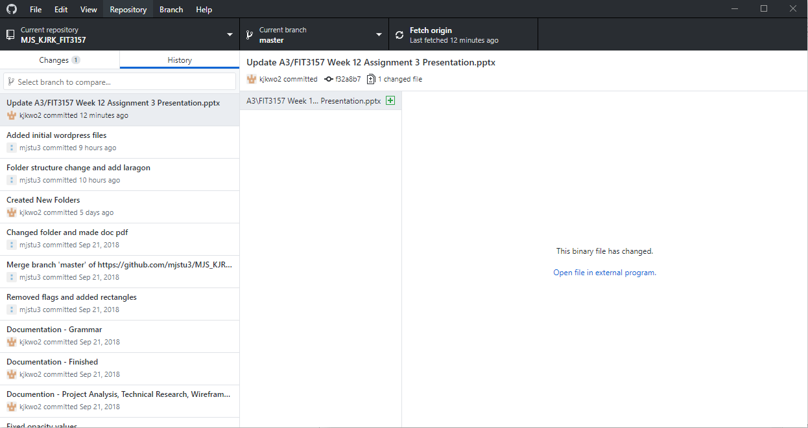


GitHub
Notice Progress
Revert Changes
Back Up Copy
Easy to work together

Slide 30
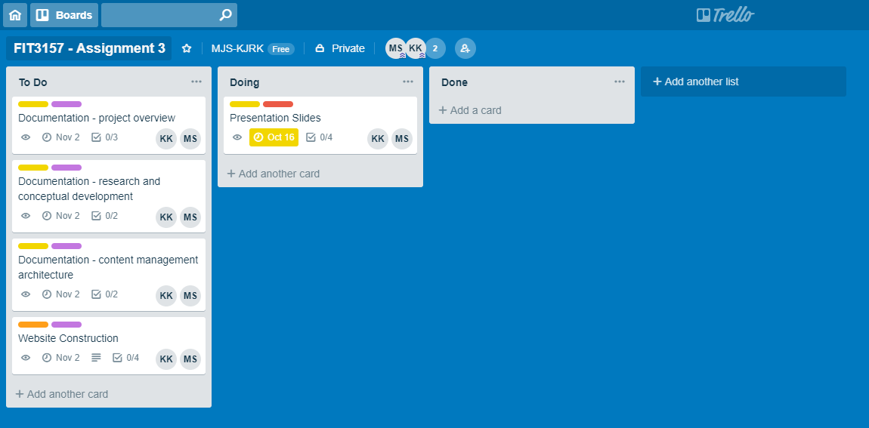


Trello
Evenly Distribute Tasks
Organized
Source of truth

Slide 31
References Pt.1
Mobile vs Desktop Usage in 2018: Mobile takes the lead [1]
https://www.stonetemple.com/mobile-vs-desktop-usage-study/
Mobile vs Desktop Usage: Mobile Grows But Desktop Still a Big Player in 2017 [2]
https://www.stonetemple.com/mobile-vs-desktop-usage-mobile-grows-but-desktop-still-a-big-player-in-2017/
5 Pros and Cons of the Mobile Desktop [3]
https://readwrite.com/2011/05/05/5-pros-and-cons-to-the-mobile-desktop/
How to make a cross browser compatible website [4]
https://medium.com/@sarahelson81/how-to-make-a-cross-browser-compatible-website-40796eaeda05
Usage share of web browsers [5]
https://en.wikipedia.org/wiki/Usage_share_of_web_browsers
Using animation to improve Mobile App User Experience [6]
https://www.shopify.com.au/partners/blog/using-animation-to-improve-mobile-app-user-experience
8 of the Most Annoying Problems with WordPress [7]
https://www.impactbnd.com/blog/problems-with-wordpress

Slide 32
References Pt.2
Ben Shneiderman’s 8 Golden Rules [8]
https://www.cs.umd.edu/users/ben/goldenrules.html
Norman, D. (2013). The design of everyday things. New York: Basic Books. [9]
The Complete Guide to Custom Post Types [10]
https://www.smashingmagazine.com/2012/11/complete-guide-custom-post-types/
WordPress Post Types [11]
https://codex.wordpress.org/Post_Types
When do you need a custom post type or taxonomy in WordPress? [12]
https://www.wpbeginner.com/beginners-guide/when-do-you-need-a-custom-post-type-or-taxonomy-in-wordpress/
WordPress Custom Fields: 101 Tips, Tricks and Hacks [13]
https://www.wpbeginner.com/wp-tutorials/wordpress-custom-fields-101-tips-tricks-and-hacks/
Assignment Brief [14]
https://moodle.vle.monash.edu/pluginfile.php/7466736/mod_resource/content/1/Presentation%203.pdf

